Slide 1
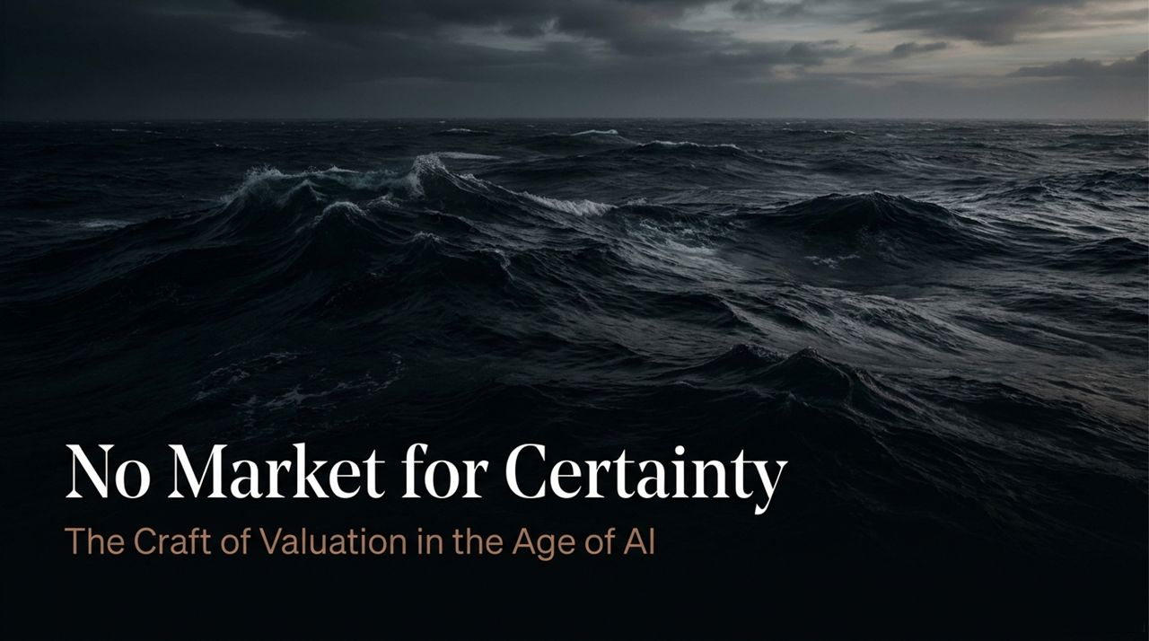
Notes:
Introduction: Welcome everyone. Today, we’re exploring 'No Market for Certainty: The Craft of Valuation in the Age of AI.' Often referred to as the 'Dean of Valuation,' Professor Aswath Damodaran reminds us that valuation is not a search for absolute truth or mathematical perfection—it is a pragmatic craft practiced under deep uncertainty.
Setting the Tone: We live in an age dominated by massive datasets, high-powered algorithms, and artificial intelligence. Yet, as tools become more sophisticated, the core essence of valuation remains surprisingly human. Valuation is fundamentally basic: if you can add, subtract, multiply, divide, and apply common sense, you can value anything.
Core Thesis: In this presentation, we will bridge the gap between financial mechanics and real-world business realities. We will walk through how valuation has evolved, why 'Excel Ninjas' fail without a supporting narrative, why a $2.5 trillion AI capex boom creates market delusions, and how investors should think under true uncertainty.
Aswath Damodaran: This Is No Market for Certainty
https://www.youtube.com/watch?v=kms3lEsj_lQ

Slide 2
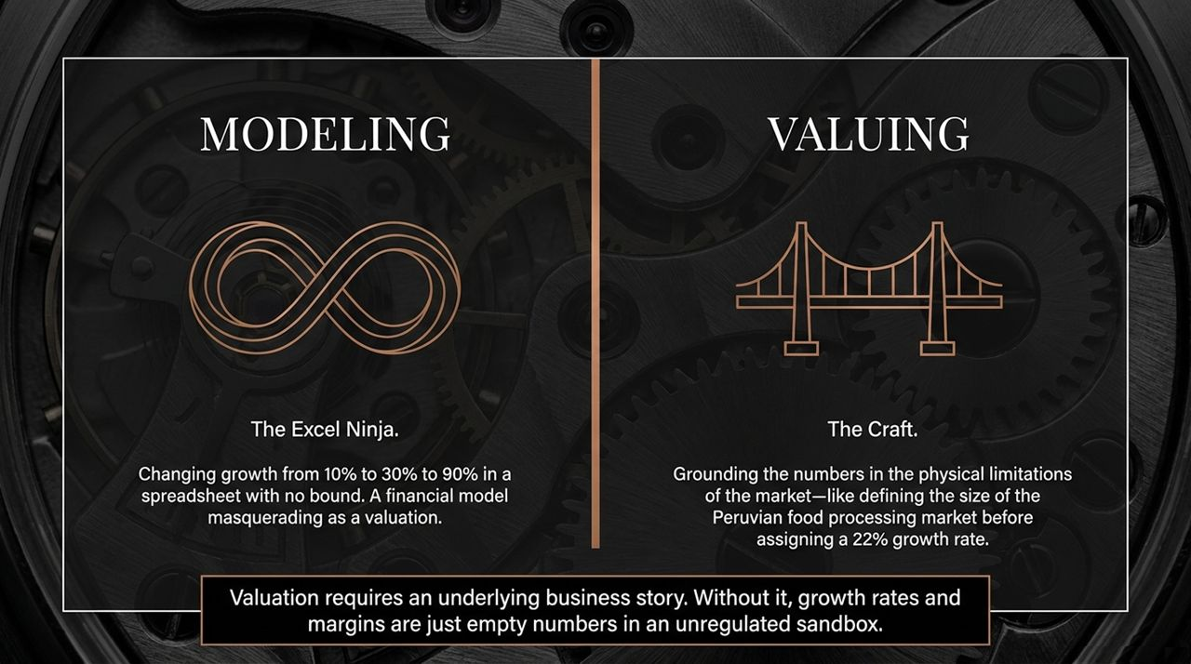
Notes:
Historical Context (1980s): Let's step back to the mid-1980s when Prof. Damodaran first started teaching finance. At the time, colleagues told him there wasn't enough material on valuation to fill an entire course. Valuations were conducted on physical ledger sheets with paper, pencils, and basic calculators. Data was scarce, and you were primarily valuing mature, well-formed companies like early Microsoft or Apple, where you could extrapolate historical statements.
The Parsimonious Advantage: Because every calculation had to be done by hand, valuations back then were forced to be parsimonious. You couldn't have 50-line item spreadsheets. To justify an input, you had to tell a compelling, logical business story.
The Present Dilemma (Excel & AI): Fast forward to today: we have access to endless data, Python, complex Excel models, and LLMs. But increased data and computing power haven't made us better at valuing companies; in many cases, it has made us worse. We have replaced true valuation with mechanical modeling. Spreadsheets have become an unregulated sandbox where people fiddle with inputs without understanding the business.
The Future Outlook: Looking ahead, AI will automate mechanical data crushing, financial screening, and spreadsheet construction. However, the core differentiator for investors will remain top-down business story synthesis.

Slide 3
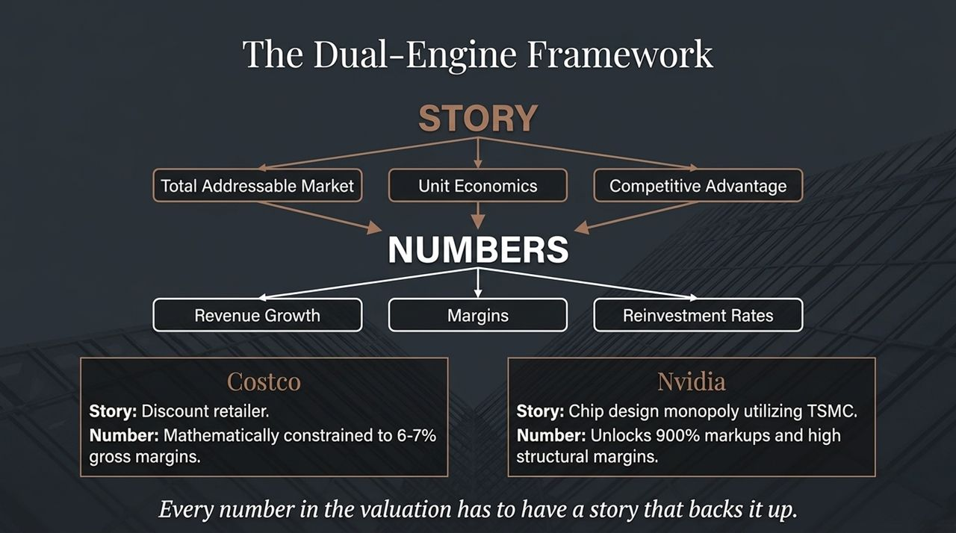
Notes:
The Fallacy of 'Excel Ninjas': There is a massive difference between modeling a company and valuing a company. An 'Excel Ninja' sits in front of a spreadsheet and changes revenue growth from 10% to 30%, or 50% to 90%. In Excel, there are no physical bounds—you can make a company worth whatever you want it to be worth by simply altering a cell.
Practicing 'The Craft': True valuation requires grounding every single number in physical, economic limitations. For example, if you are valuing a food processing company in Peru and assign it a 22% growth rate, you cannot justify that number with an equation or another number. You must justify it by defining the total size of the Peruvian food market, the competitive landscape, and how the company will capture that share.
Key Takeaway: Valuation requires an underlying business story. Without a grounded story, growth rates and margins are just empty, meaningless numbers floating in a spreadsheet.

Slide 4
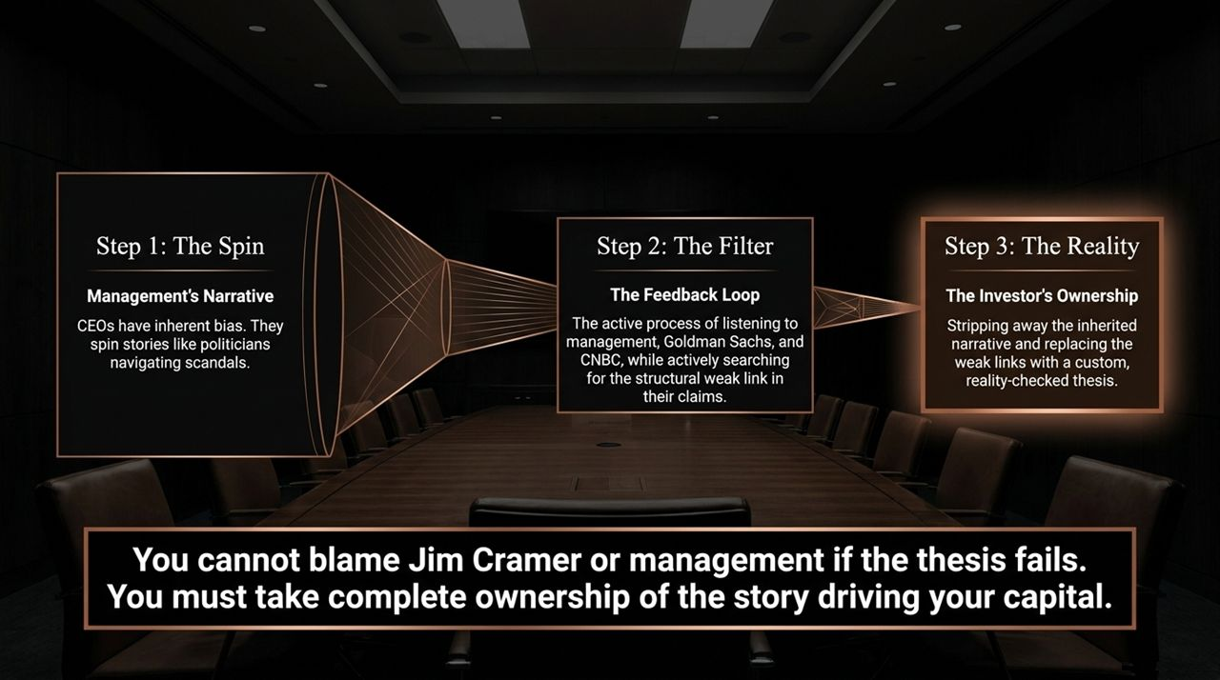
Notes:
Complementary Engines: Narrative and numbers are not contradictory; they are complementary engines. Every number in a valuation must have a backing story, and every story must be tested against financial numbers.
Story Inputs vs. Number Outputs: Story dimensions like Total Addressable Market (TAM), Unit Economics, and Competitive Advantages map directly into Revenue Growth, Operating Margins, and Reinvestment Rates.
Case Study 1 — Costco: Look at Costco. They are an incredible, well-managed discount retailer. But their gross margins are mathematically constrained to around 6% to 7%. Why? Because that is the fundamental narrative of discount retailing. You cannot plug a 40% gross margin into an Excel model for Costco, no matter how much you like the company, because the story doesn't support it.
Case Study 2 — Nvidia: Conversely, look at Nvidia. Nvidia's story is a chip design monopoly that outsources heavy manufacturing to TSMC. This capital-light design moat unlocks 900% markups and high structural operating margins that are roughly double any other chip maker. Their valuation reflects that specific business reality.

Slide 5
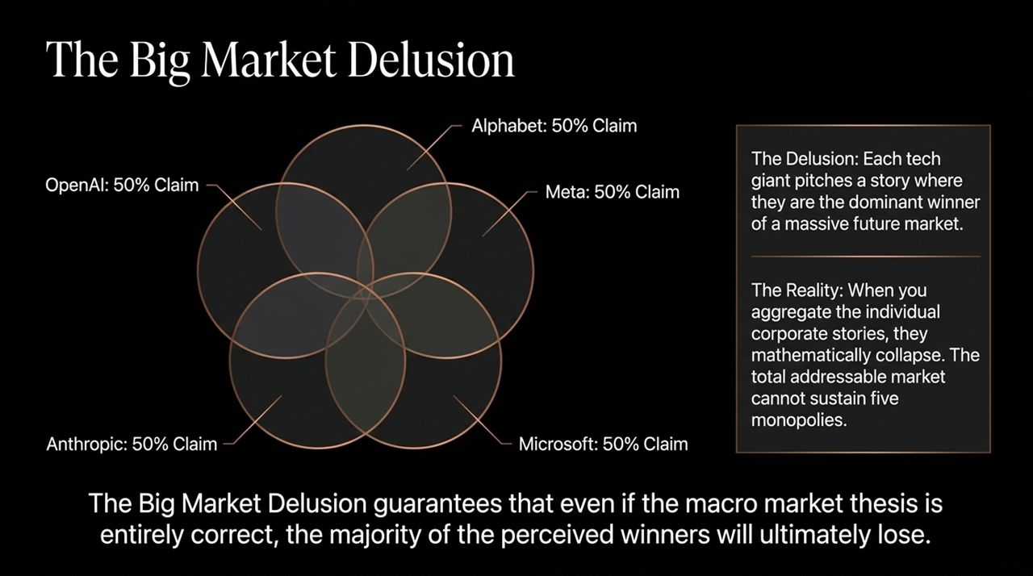
Notes:
Step 1 — The Spin: Management always presents a narrative. CEOs have inherent, structural biases—they spin stories much like politicians navigating a scandal. They will always present their company in the best possible light.
Step 2 — The Filter & Feedback Loop: As investors, we must keep our feedback loop open. We listen to management, read Goldman Sachs equity research reports, and watch commentators on CNBC. But our primary job during this process is to actively search for the structural weak link in their claims.
Step 3 — Taking Ownership: Once you find that weak link, you must strip away the inherited narrative and replace it with your own reality-checked thesis. It is your money on the line, not management's or Jim Cramer's.
Accountability: If your investment thesis fails, you cannot blame external commentators or corporate spin. You must take 100% ownership of the story that drives your capital.

Slide 6
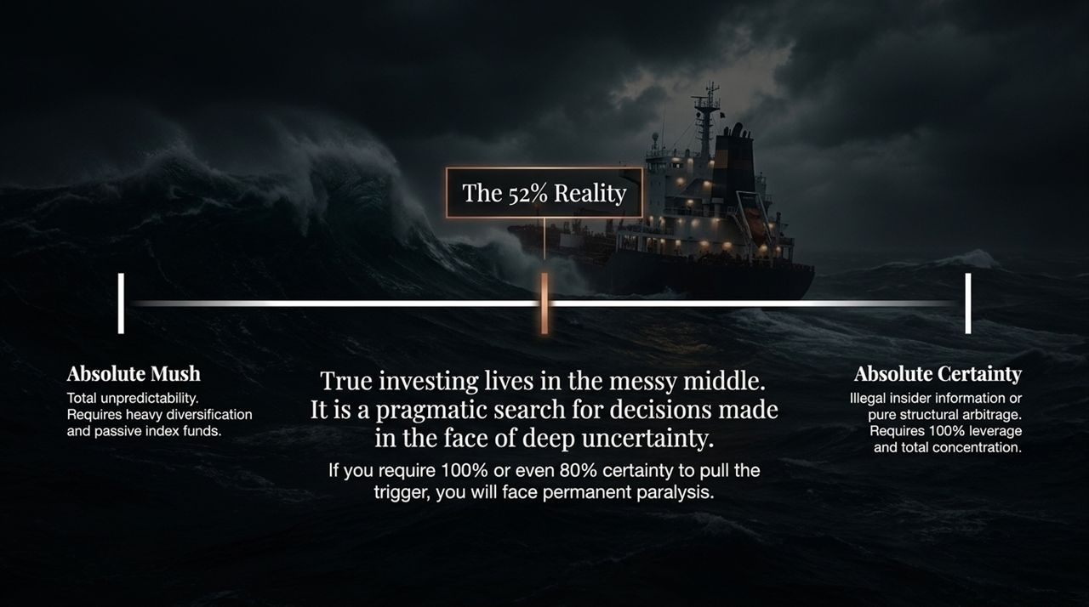
Notes:
Defining the Delusion: When massive, disruptive technological shifts occur, the market falls prey to 'The Big Market Delusion'. We saw this with PCs in the 1980s, the Dot-com boom in the 90s, and Smartphones and Social Media in the 2000s. Today, we see it in Artificial Intelligence.
Aggregating Corporate Stories: If you listen to OpenAI, Alphabet, Meta, Anthropic, or Microsoft individually, each presents a compelling, highly plausible narrative where they capture 50% or more of the future AI market.
Mathematical Collapse: However, when you aggregate these individual corporate stories together, they mathematically collapse. The total addressable market cannot physically or economically sustain five separate dominant monopolies.
The Investor Warning: The Big Market Delusion guarantees that even if the overarching macro thesis is 100% correct—meaning AI truly does transform society—the majority of individual corporate 'winners' being priced today will ultimately lose.

Slide 7
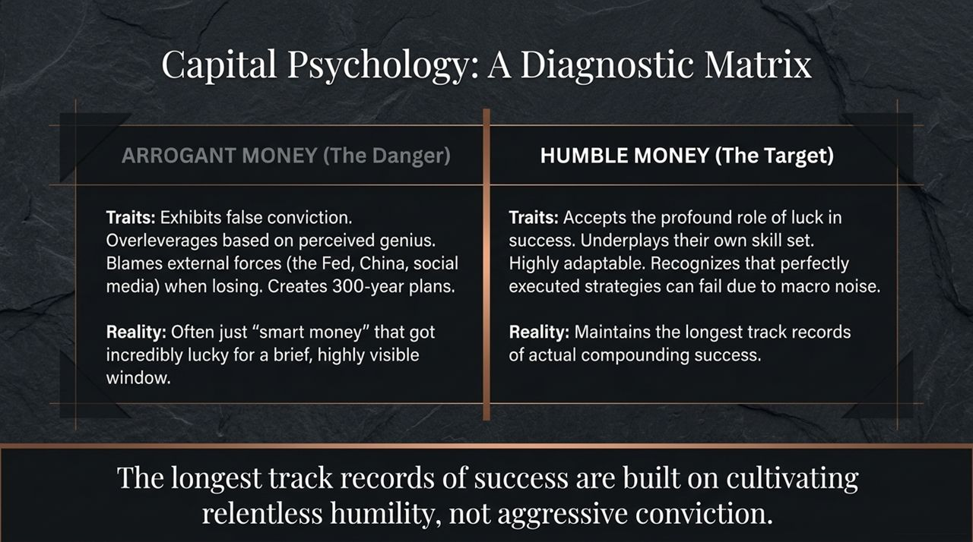
Notes:
The Spectrum Bounds: Investing exists on a continuum. At one extreme, you have 'Absolute Mush'—total unpredictability where you cannot nail down any inputs. If you are here, you belong in passive index funds. At the other extreme, you have 'Absolute Certainty'—which only exists in illegal insider trading or riskless structural arbitrage. Under true certainty, you would use 100% leverage and total portfolio concentration.
The Messy Middle (The 52% Reality): Real-world investing happens strictly in the messy middle. It is a pragmatic search for decisions made in the face of deep, uncontrollable uncertainty.
Accepting a Realistic Hit Rate: Even if you gather all available data, build the best models, and execute flawlessly, your long-term success rate will likely be around 52% to 55%. You will be wrong nearly half the time simply because the future is out of your control.
Overcoming Paralysis: If you demand 80% or 100% certainty before pulling the trigger, you will face permanent decision paralysis and never invest.

Slide 8
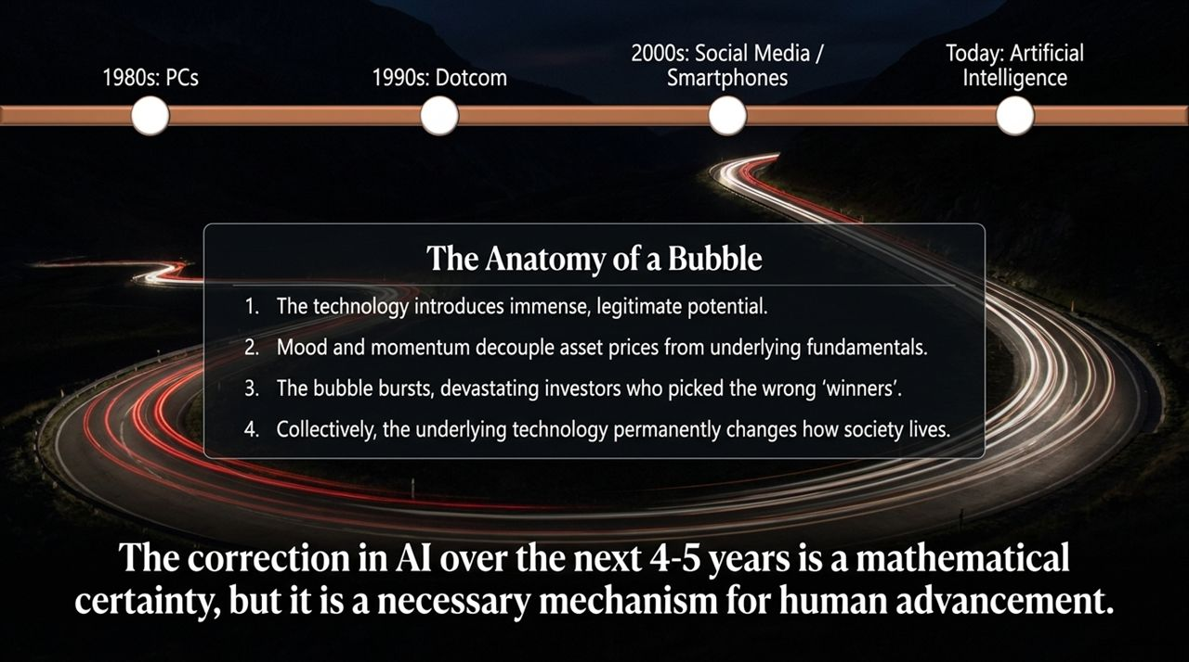
Notes:
Arrogant Money: Wall Street often talks about 'Smart Money,' but in 40 years of practicing valuation, Prof. Damodaran notes he has never found true smart money—only 'Arrogant Money' vs. 'Humble Money'. Arrogant money exhibits false conviction. It overleverages and concentrates capital based on perceived genius. When it wins, it credits its own intellect; when it loses, it blames external forces like the Fed, China, or market irrationality. Masayoshi Son’s 300-year plan for SoftBank or overhyped hedge funds are classic examples.
Humble Money: Humble money recognizes the profound role of luck and timing in financial returns. Humble investors underplay their own skill, stay highly adaptable, and acknowledge that perfectly constructed strategies can fail due to macro noise.
Building a Track Record: The longest, most durable compounding track records in financial history are built by cultivating relentless humility, not aggressive conviction.

Slide 9
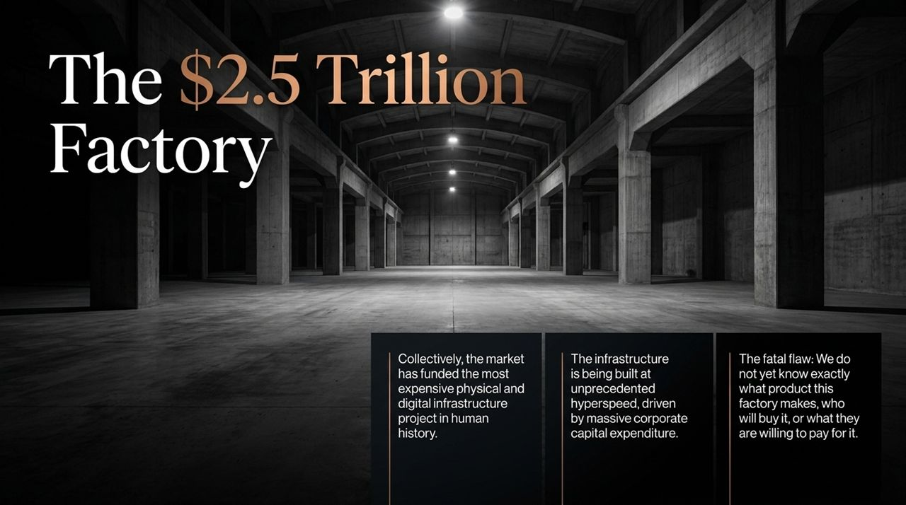
Notes:
The 4-Step Cycle: Every major tech paradigm follows a predictable 4-step bubble lifecycle:
A revolutionary technology introduces immense, legitimate transformational potential.
Market mood and momentum decouple asset pricing from underlying financial fundamentals.
The bubble bursts, causing severe capital loss for investors who picked the wrong individual winners.
Despite the crash, the underlying technology permanently alters how human society operates.
Historical Precedents: We saw this exact sequence with PCs in the 1980s, the Dot-com crash in 2000, and Social Media/Smartphones. The Dot-com crash wiped out trillions in paper wealth, yet the internet fundamentally changed the world.
AI Prediction: A structural market correction in AI over the next 4 to 5 years is a mathematical certainty. However, this correction is not a disaster—it is the necessary historical mechanism through which capital is rationalized and human advancement occurs.

Slide 10
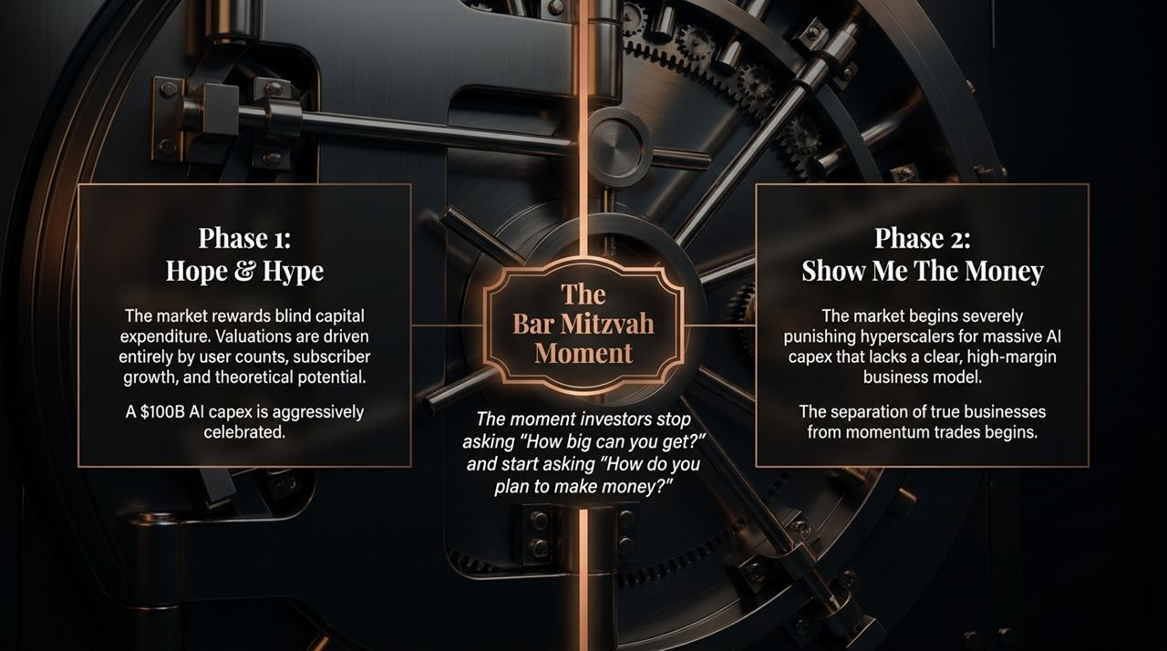
Notes:
The Capex Reality: To understand where we are in the current AI cycle, consider this aggregate metric: the global market has poured nearly $2.5 trillion into AI capital expenditure.
The Factory Analogy: Imagine that the technology industry has collectively built the largest, most expensive physical and digital factory in human history. It has been constructed at unprecedented hyperspeed.
The Structural Flaw: Here is the fatal flaw: we have built a $2.5 trillion factory, but we do not yet know exactly what product this factory makes, who the ultimate end-customers are, or what they will be willing to pay for its output.
The Investor Risk: Hyperscalers are making enormous, aggressive capital bets hoping that demand and monetization models emerge organically before the depreciation and capital costs crush their returns.

Slide 11
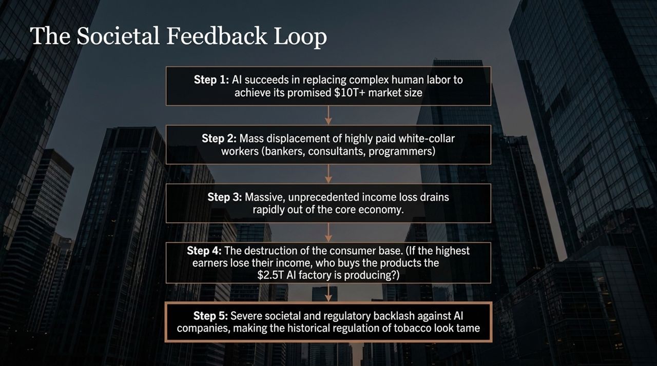
Notes:
Phase 1 — Hope & Hype: In the early stages of a tech wave, markets reward blind capital spending. Valuations are driven entirely by headline user counts, subscriber growth, and theoretical addressable markets. Three years ago, when a Big Tech hyperscaler announced a $50 billion or $100 billion AI capex increase, the stock price was aggressively celebrated.
The Bar Mitzvah Moment: Prof. Damodaran uses the term 'Bar Mitzvah Moment' to describe the exact inflection point in a business lifecycle where investors stop asking 'How big can you get?' and start asking 'How do you plan to make money?'
Phase 2 — Show Me The Money: We are entering Phase 2 right now. Today, when hyperscalers announce massive AI capex without showing immediate, high-margin revenue generation, the market punishes them. This phase forces the separation of true, durable businesses from pure momentum trades.

Slide 12
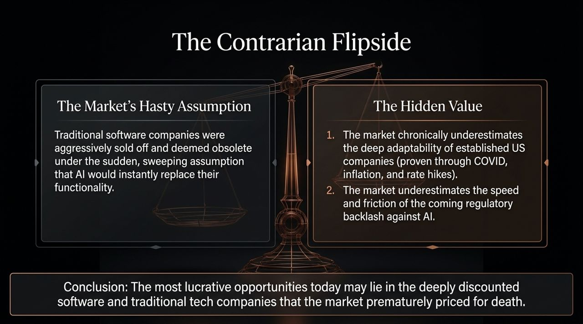
Notes:
The Paradox of Success: There is a deep, systemic feedback loop that AI enthusiasts often overlook. If AI achieves the $10 trillion+ TAM that its strongest advocates predict, it can only do so by directly replacing complex human labor.
White-Collar Displacement: Thirty years ago, industrial automation disrupted blue-collar factory workers. But AI targets the highest-paid white-collar knowledge workers in the economy: financial analysts, bankers, corporate lawyers, software programmers, and consultants.
Economic Contagion: If the top 10% or 20% of income earners suffer structural job displacement and income loss, that capital rapidly drains out of the broader consumer economy. This creates a severe paradox: If the highest earners lose their livelihoods, who remains to buy the products and services that the $2.5 trillion AI factory generates?
Regulatory Backlash: Furthermore, displaced knowledge workers hold significant political and institutional influence. The resulting regulatory and political backlash against AI enterprises will make historical anti-tobacco regulations look tame.

Slide 13
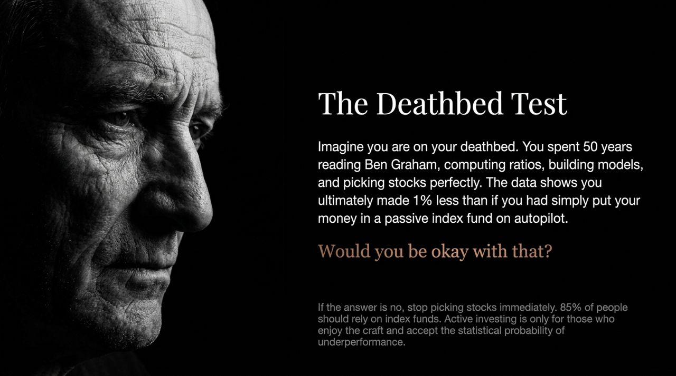
Notes:
The Premature Death of Software: Every market mania creates an equal and opposite mispricing. Over the past two years, traditional software and SaaS companies were heavily sold off under the sweeping assumption that AI tools would instantly render their platforms obsolete.
Underestimating Adaptability: This sell-off ignores two key facts: First, the market chronically underestimates the deep operational adaptability of established US enterprise companies—proven repeatedly through COVID-19 lockdowns, supply chain crises, rapid inflation, and rate hikes.
Regulatory Friction: Second, the market underestimates the sheer friction, enterprise sales cycles, and regulatory pushback that will slow down complete AI adoption.
Contrarian Opportunity: Consequently, some of the most attractive, risk-adjusted value opportunities today may lie in deeply discounted software and traditional tech firms that Mr. Market prematurely priced for extinction.

Slide 14
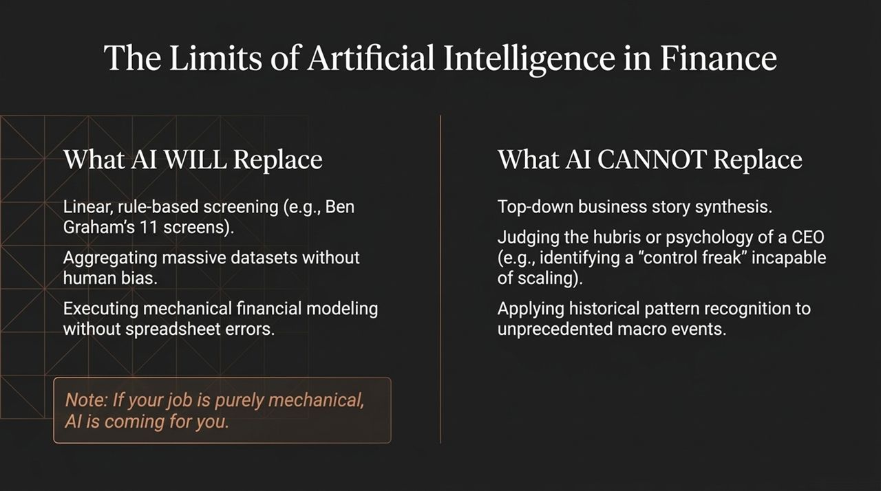
Notes:
The Philosophical Question: Prof. Damodaran presents a simple psychological test for anyone considering active stock picking. Imagine you are on your deathbed 40 or 50 years from now. You spent your entire life studying Ben Graham, analyzing financial statements, computing ratios, and building complex valuations.
The Reveal: Then, someone shows you the final data: despite all your hard work, your active portfolio returned 1% less than if you had simply put your money into a passive low-cost index fund on autopilot on day one.
The Litmus Test: Ask yourself: Would you be okay with that outcome?
The Conclusion: If your answer is no, you should stop picking individual stocks immediately and put your money into index funds. Passive vehicles are the right choice for 85% of investors. Active investing should only be pursued by those who truly enjoy the process and craft itself, fully accepting the statistical likelihood of underperformance.

Slide 15
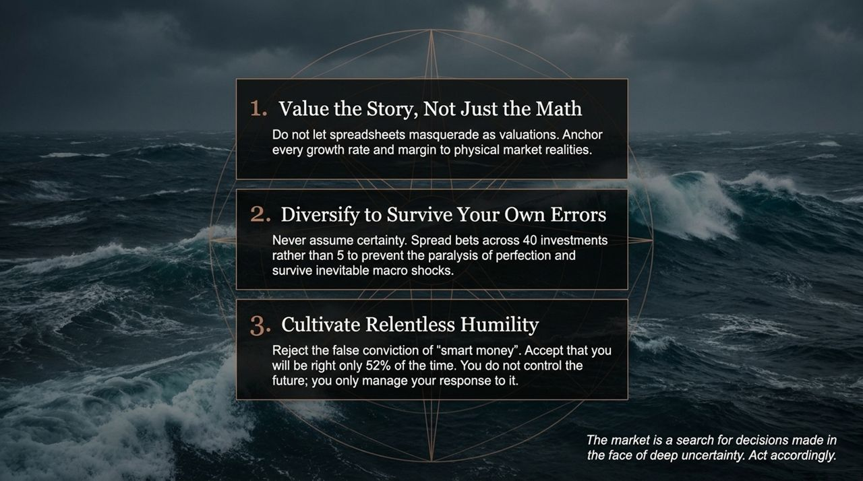
Notes:
What AI Will Automate: As AI enters financial services, we must be clear about what it can and cannot do. AI will easily replace linear, rule-based screening—such as mechanical Ben Graham screens. It will aggregate massive datasets without human bias and execute financial modeling without spreadsheet calculation errors. If your day job is purely mechanical financial modeling, AI is coming for you.
What AI Cannot Replicate: What AI cannot replicate is top-down business story synthesis. AI cannot evaluate executive psychology—such as recognizing that a founder's control-freak nature will prevent a startup from scaling 10x. Nor can AI intuitively apply historical pattern recognition to unprecedented macro shocks.
The Analyst's Path: AI is a super-efficient analyst, but it lacks qualitative business judgment. If you rely solely on mechanical screens, AI will make your mistakes faster and at a much larger scale.

Slide 16
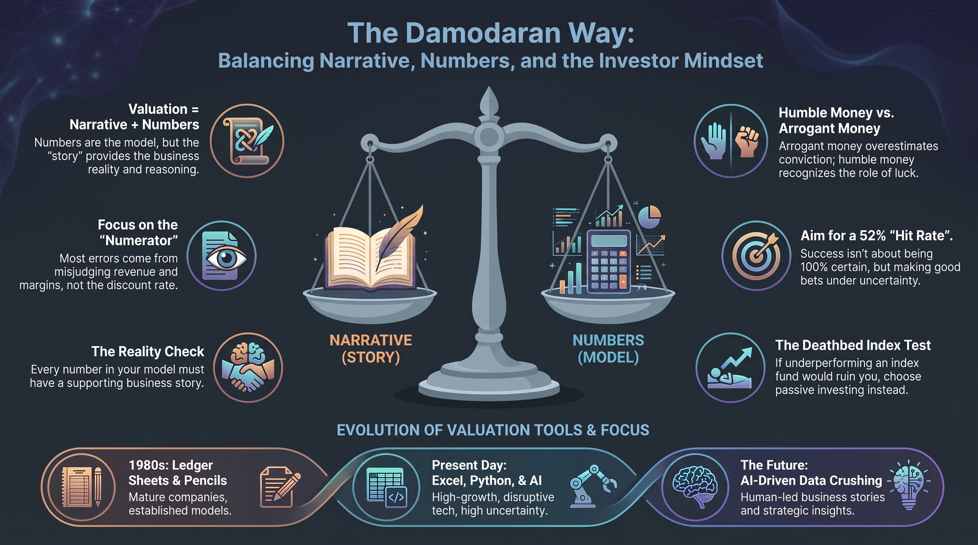
Notes:
Principle 1 — Story + Math: First, value the business story, not just the math. Never let spreadsheets masquerade as valuations. Every growth rate, margin, and reinvestment rate must be anchored to physical market realities.
Principle 2 — Diversify to Survive Errors: Second, diversify to survive your own inevitable errors. Do not hold a hyper-concentrated portfolio of 5 stocks where a single mistake paralyzes you. Spread your bets across 30 to 40 investments where the odds are in your favor, giving yourself the structural flexibility to act under deep uncertainty.
Principle 3 — Relentless Humility: Third, cultivate relentless humility. Reject false conviction and the illusion of 'smart money'. Accept that you will be wrong roughly half the time. You cannot control the future or macro market movements—you can only control your process and your response to them.
Final Concluding Thought: Valuation is not about finding a single 'true' value or seeking absolute certainty. The market is a search for decisions made in the face of deep uncertainty—act accordingly.
Aswath Damodaran: This Is No Market for Certainty
https://www.youtube.com/watch?v=kms3lEsj_lQ

